Slide 1
Casting Tool Calculator Manual

Slide 2
Table of Contents
General Flow
Types of Files
Excel File
CSV File
Format of Saving Files
Editing the file

Slide 3
Design Flow
Open casting Folder and you can find the “index.html”
Right click the file and open it in “Internet Explorer”
Upload Two Files :
grade.csv
raw_material.csv
Enter the casting details
Choose the level 4 a pop up will get open
In the pop up upload three files
level_4.csv
Power.csv
Spec.csv
Then click “get cast” button and find the good casting cost in “Cost per kg Good casting “ table.

Slide 4
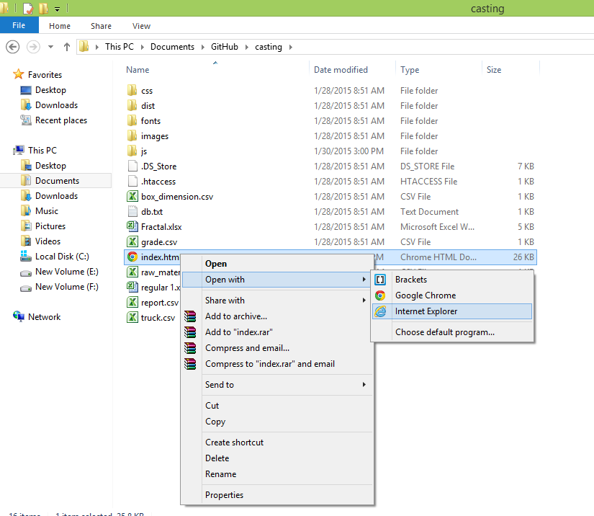
Open the File in Browser
Go to the casting folder
You can find “index.html”
Right click index.html and select “open with” and open it in “Internet Explorer”

Slide 5
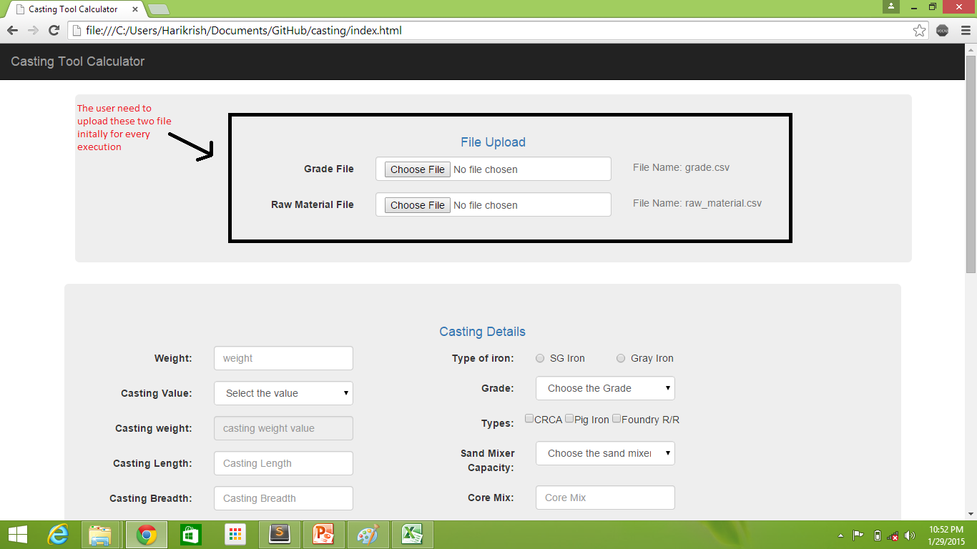

Slide 6
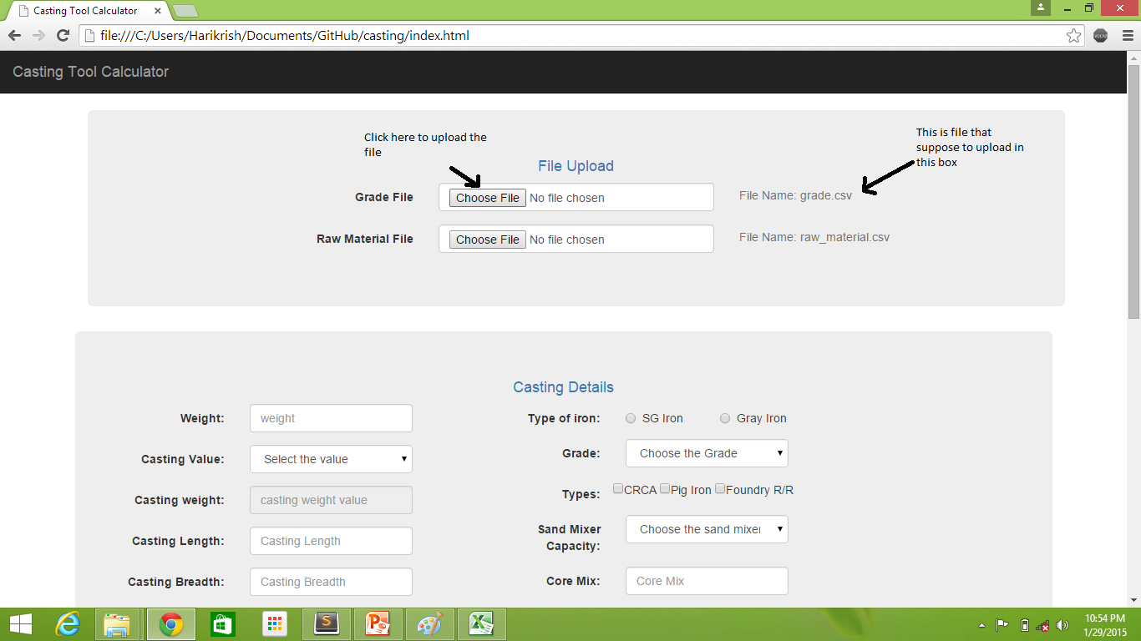

Slide 7
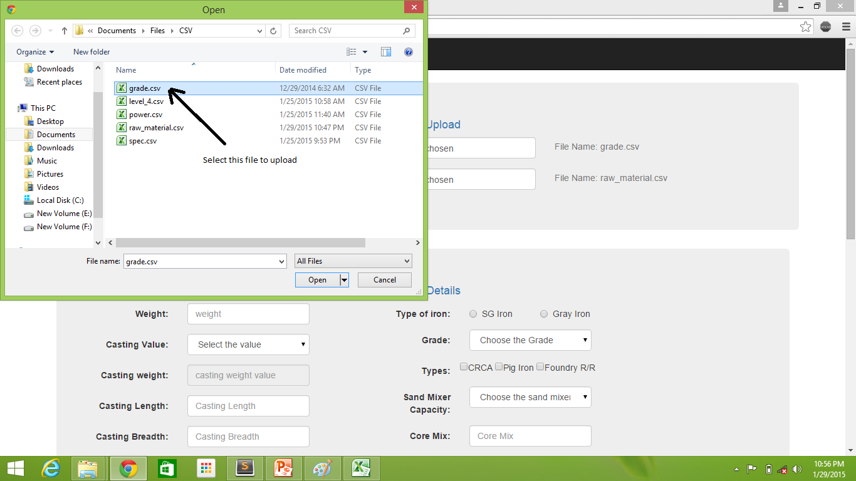

Slide 8
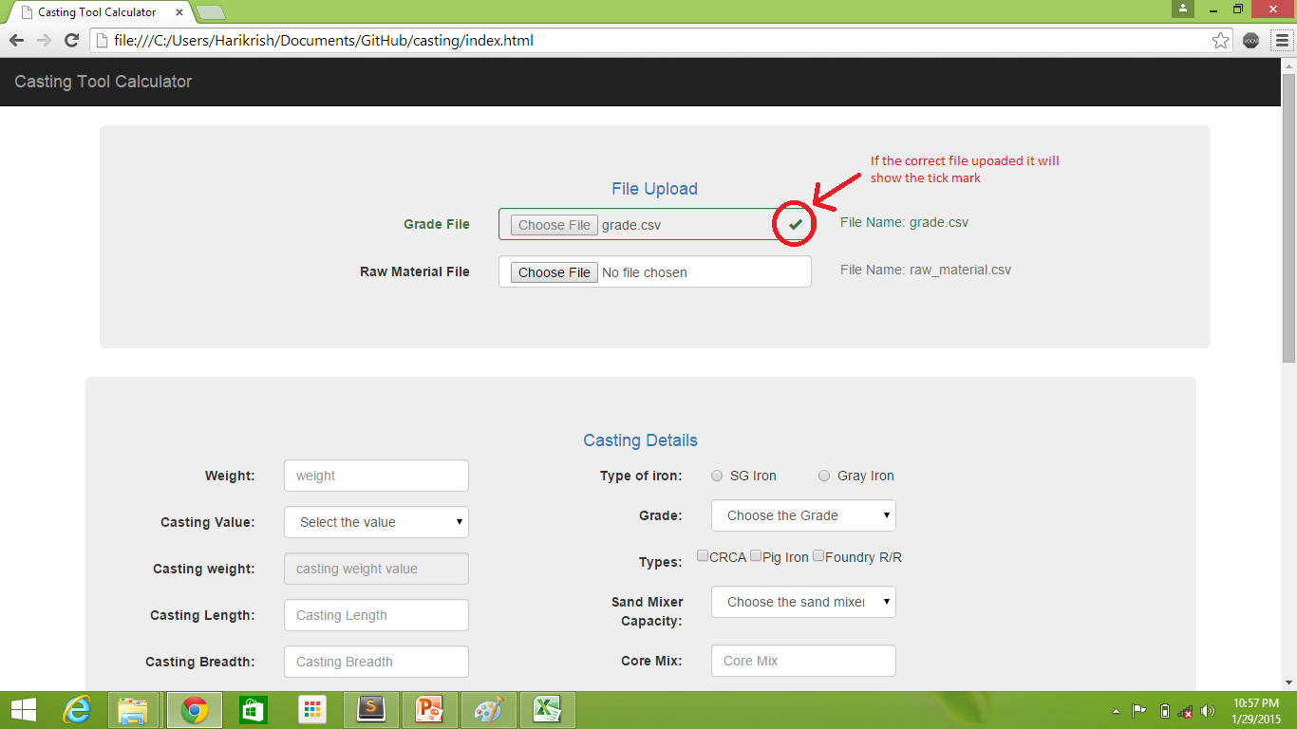

Slide 9
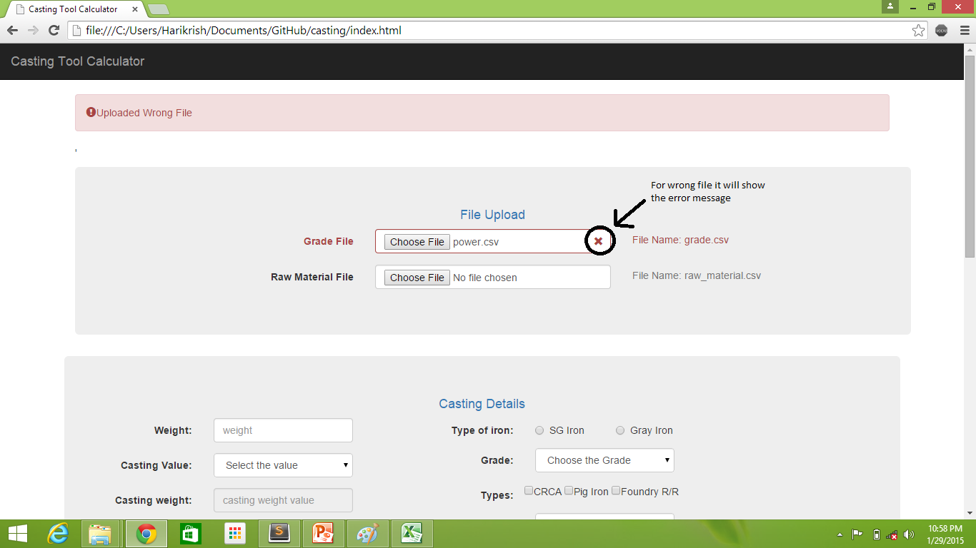

Slide 10
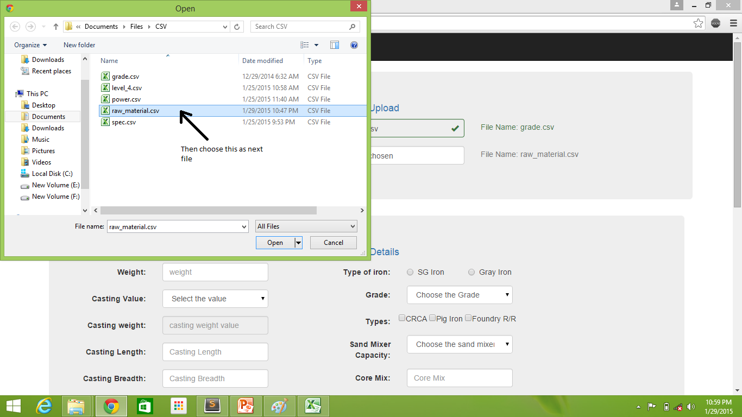

Slide 11
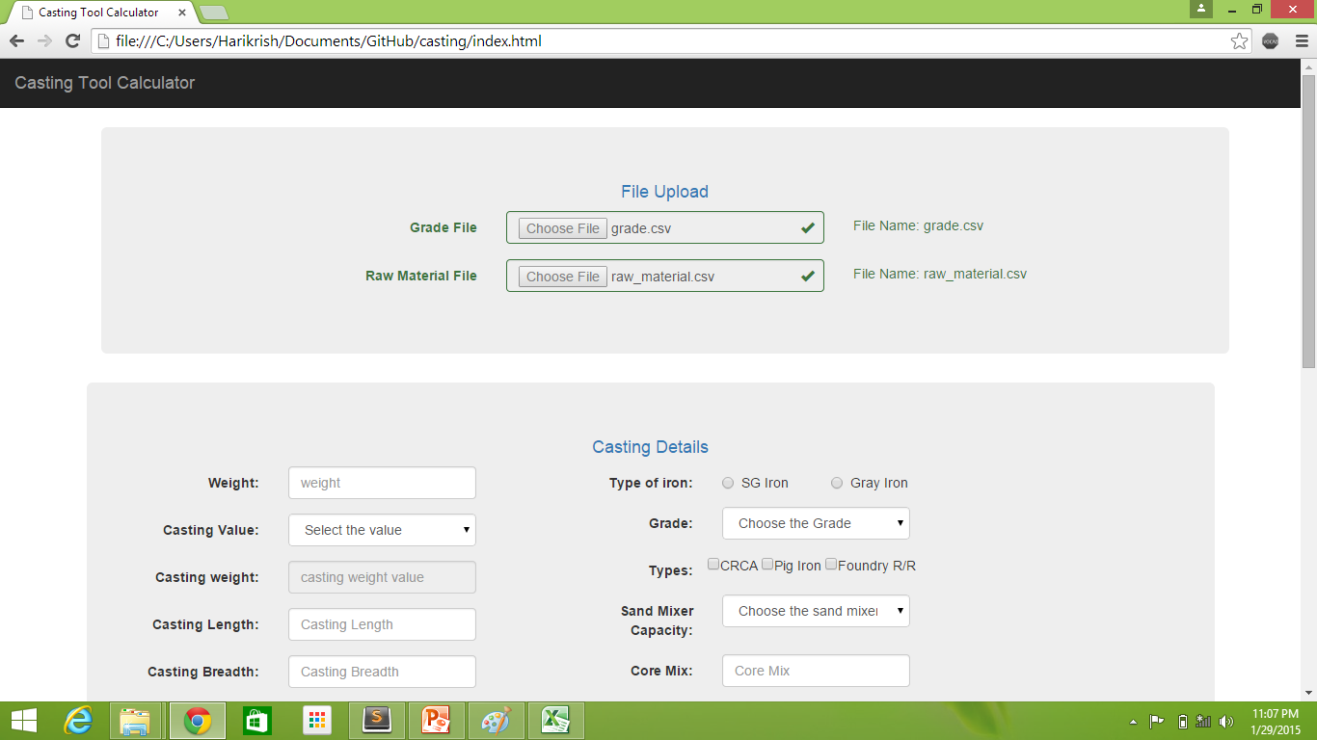

Slide 12
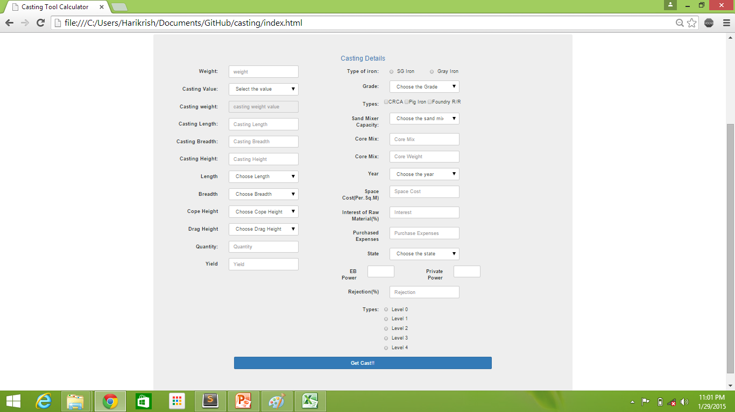

Slide 13
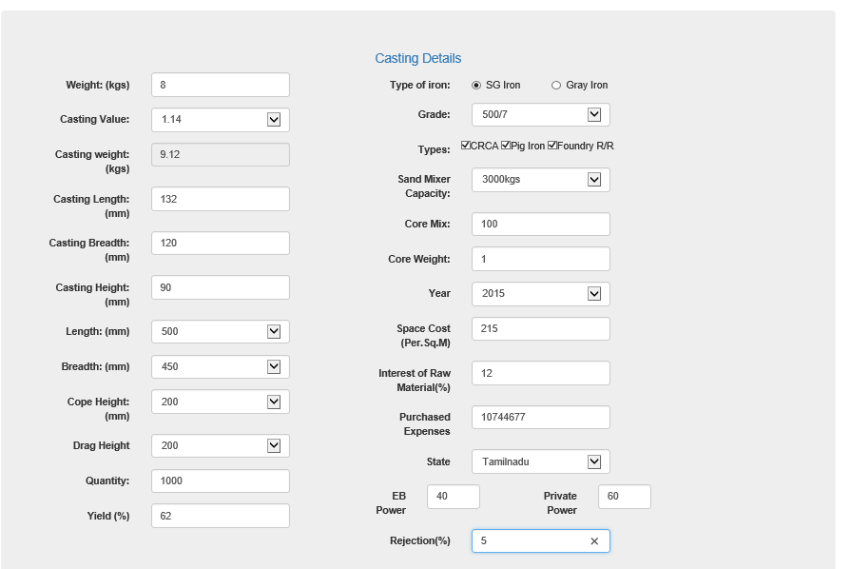
Casting Details
Enter all the values and it is mandatory
Default values:
Enter the default values if there is no change in it.
Core Weight = Enter “1”
Space Cost = “215”
Purchased Cost = Overall Expenses(default: “10744677”)
Rejection = Enter 5%

Slide 14
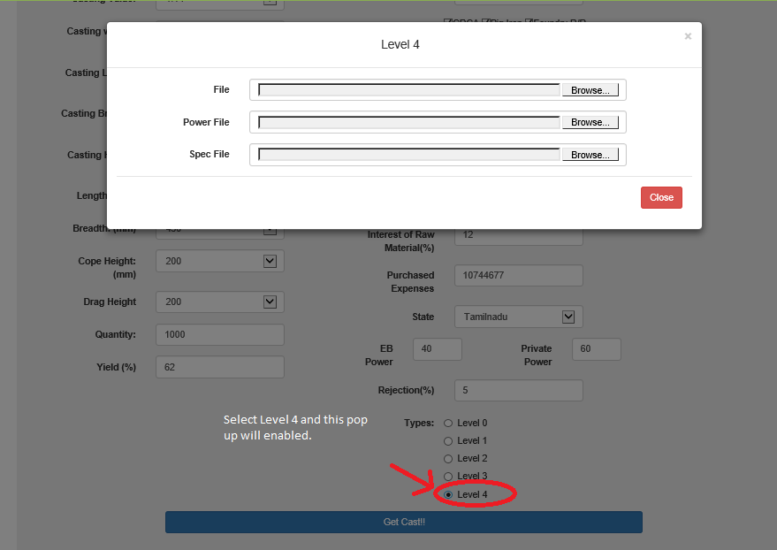
File Upload based on the level chosen
Select the level 4 in the radio button a popup will show up
In this pop up you have to upload three file:
In the First input box you have to upload “level_4.csv”.
Second Input Box “power.csv”
Third Input Box “spec.csv”

Slide 15
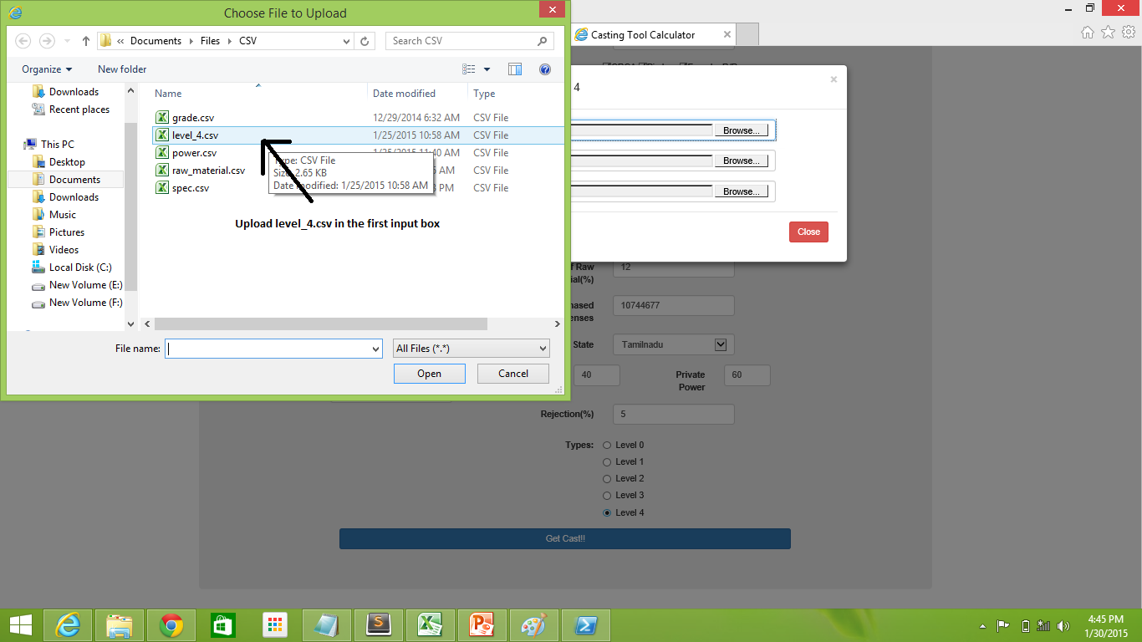
First File
File Name: level_4.csv

Slide 16
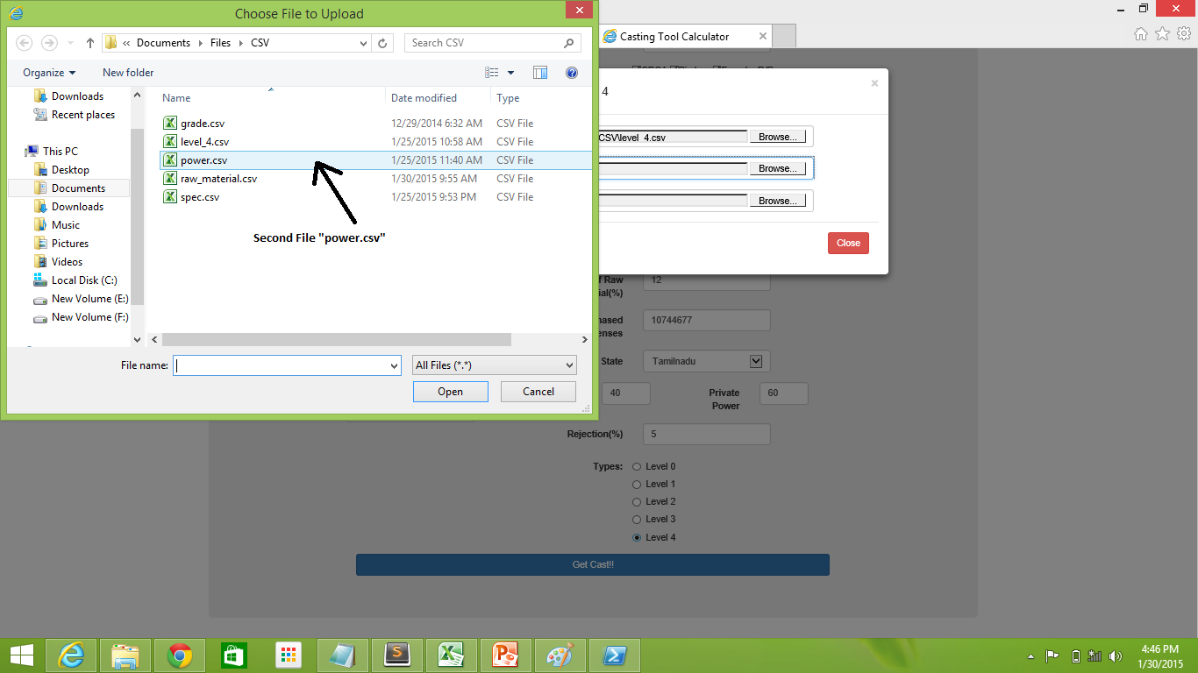
Second File
File name: power.csv

Slide 17
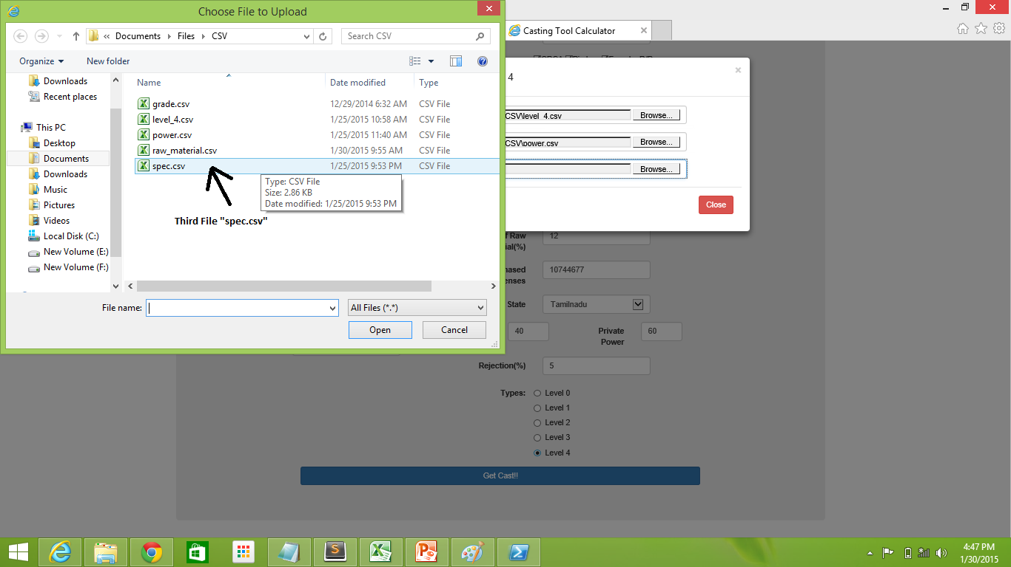
Third File
File Name: spec.csv

Slide 18
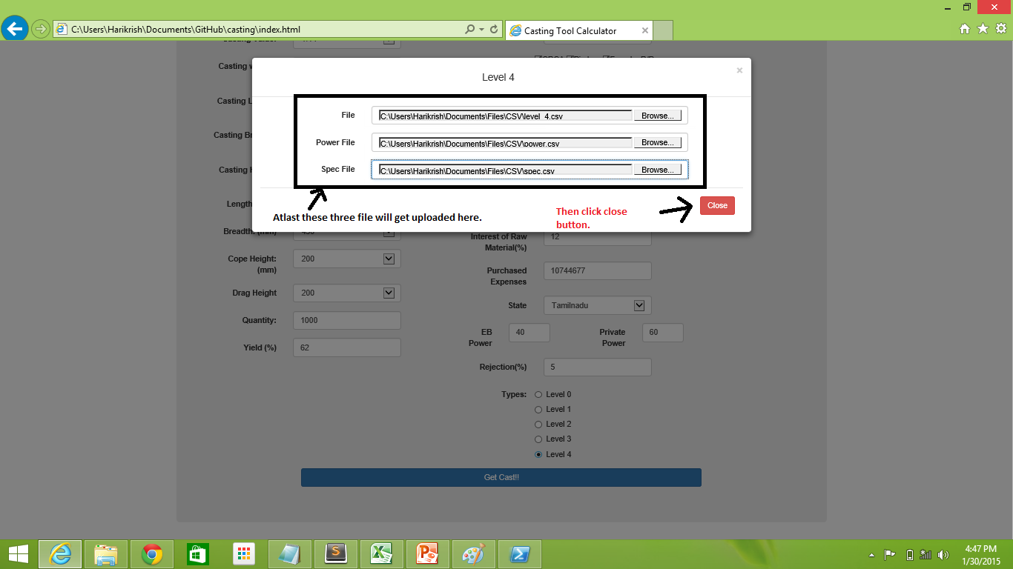
At last the file will get upload

Slide 19
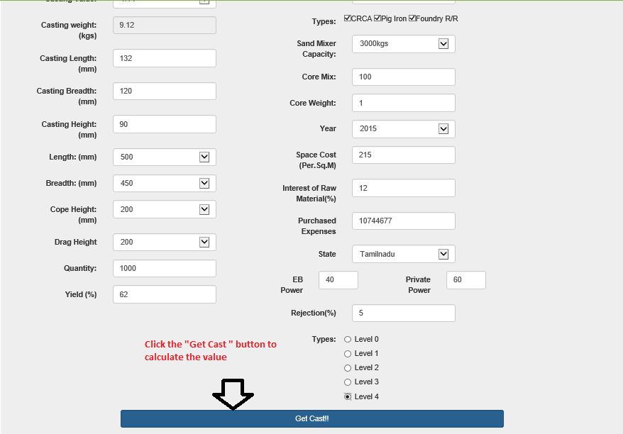
To calculate:
To start calculation click get calculate button.

Slide 20

Sand Requirement
After click the get calculate button sand requirement is get calculated .
To see the preview of the casting click the preview icon.
Preview of the casting is shown in next slide

Slide 21
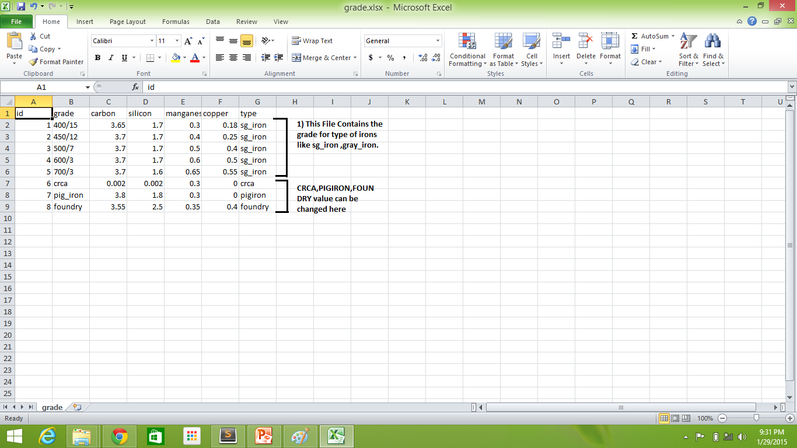
File Name: grade.xlsx

Slide 22
Preview

Slide 23
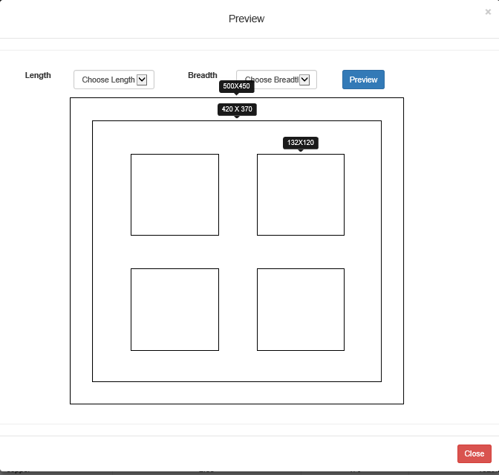
Preview :
The preview of the chosen casting dimension is shown here.
You can see the preview of various box dimension by changing the length and breadth.

Slide 24
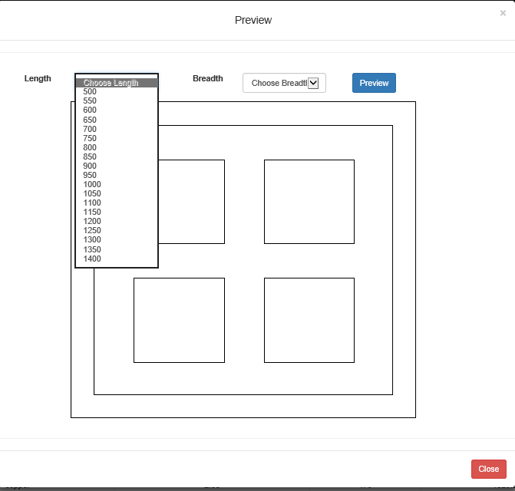
Box length:
Changing the box Length

Slide 25
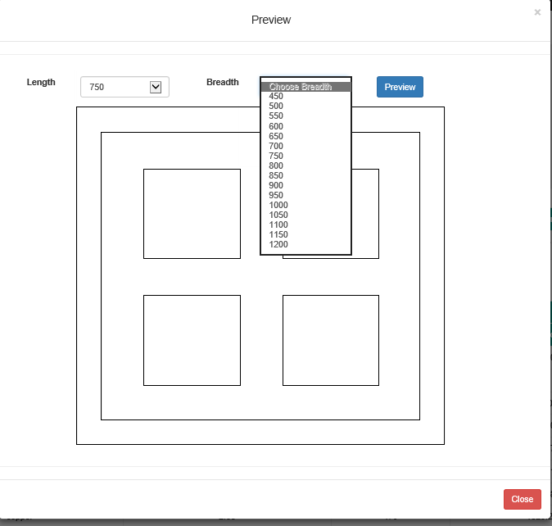
Box Breadth:
Changing the box breadth dimension

Slide 26
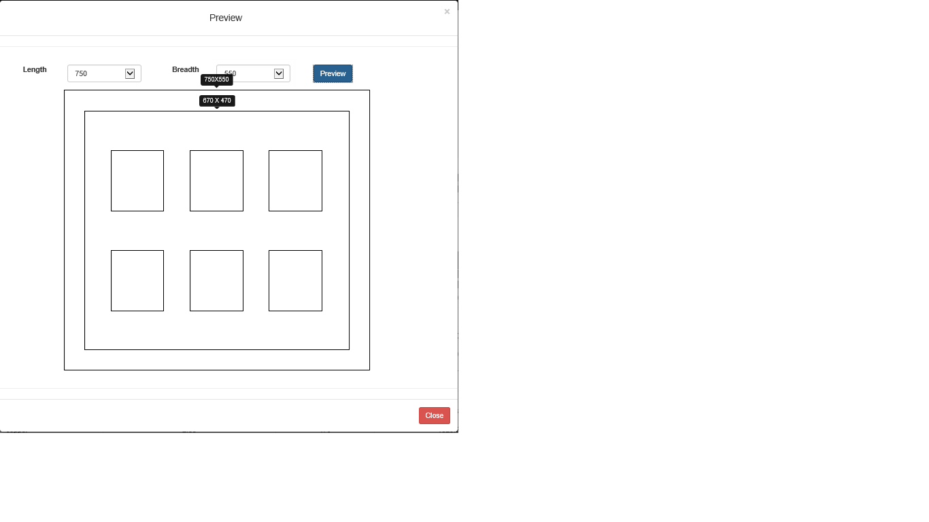
Changed box dimension preview

Slide 27
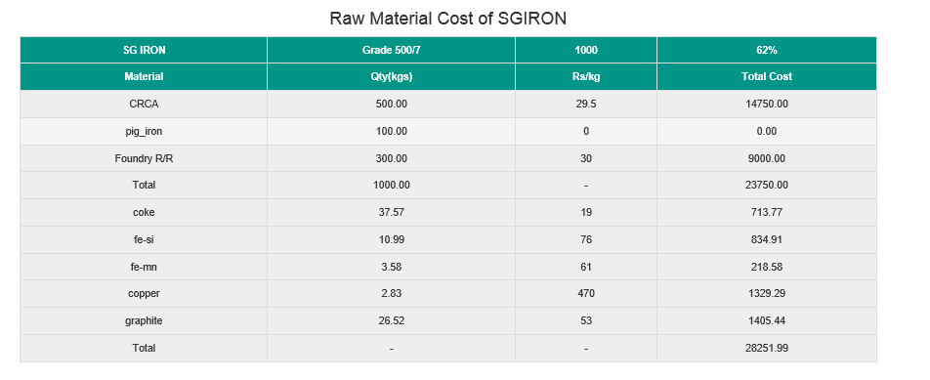
Raw Material Cost

Slide 28
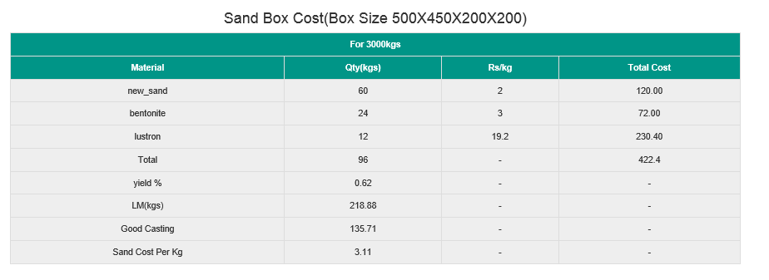
Sand Box Cost

Slide 29
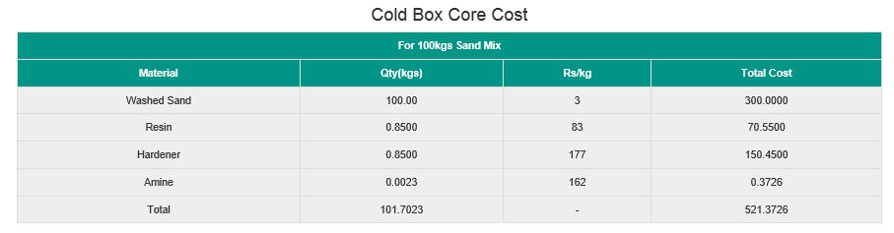
Cold Box Core Cost

Slide 30
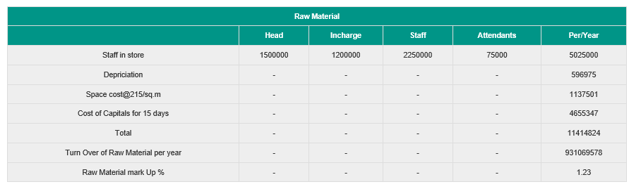
Raw Material Mark Up

Slide 31
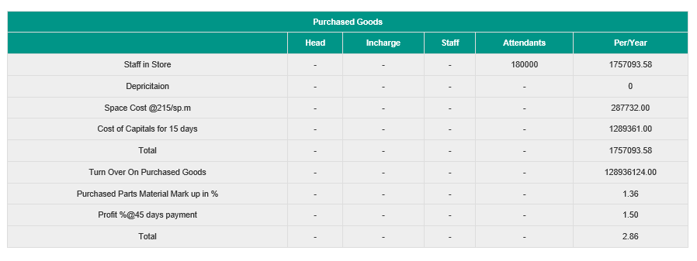
Purchased Goods

Slide 32
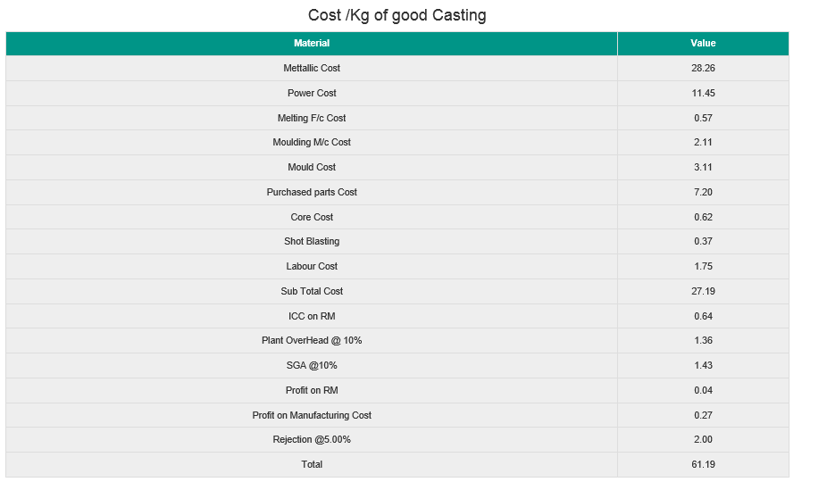
Cost Per Kg of Good Casting
Final Required Value

Slide 33
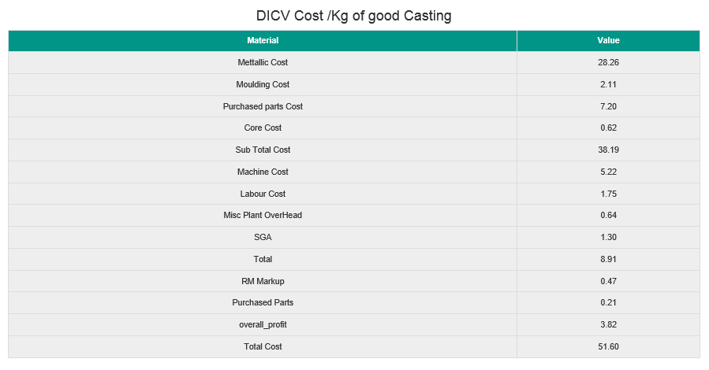
DICV Cost Per KG of Good Casting

Slide 34
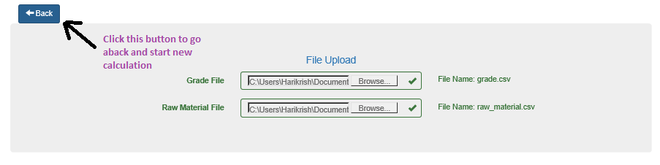
To Start New Calculation
Click Back Button to start new calculation

Slide 35
Files

Slide 36
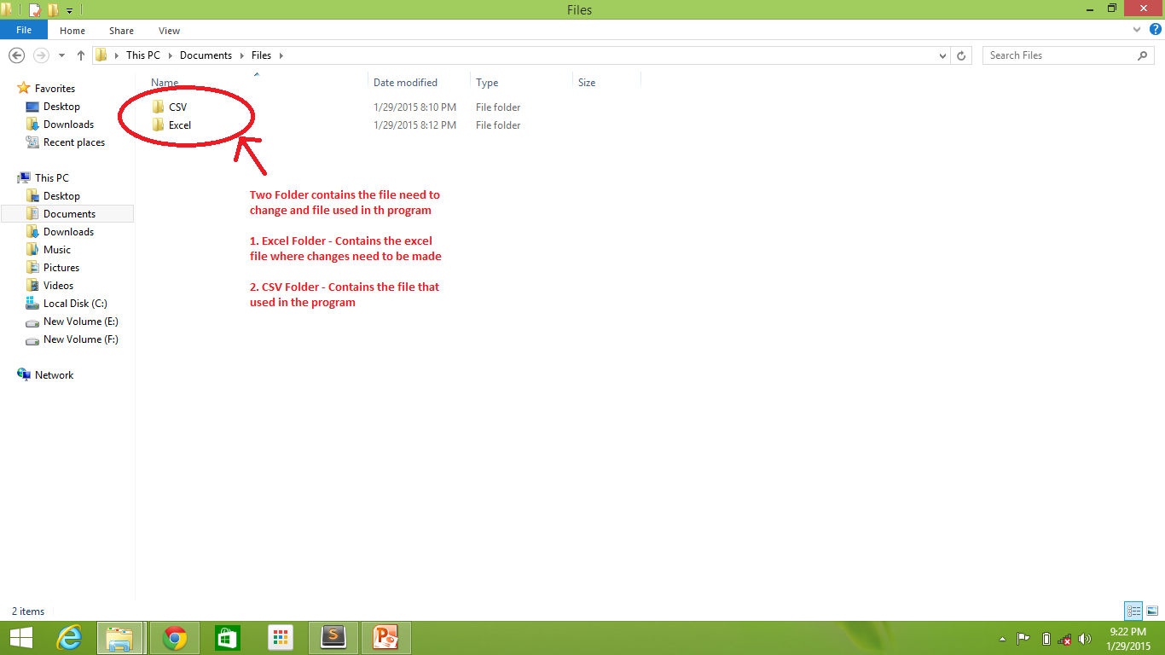

Slide 37
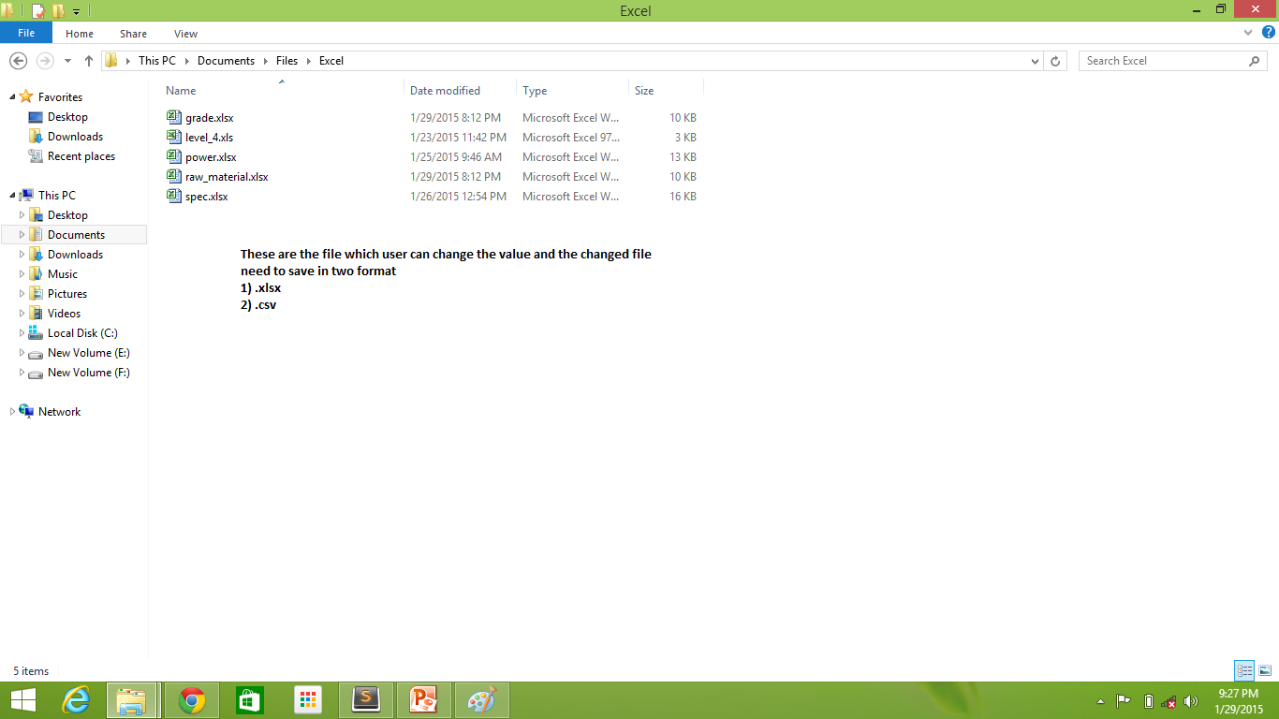

Slide 38
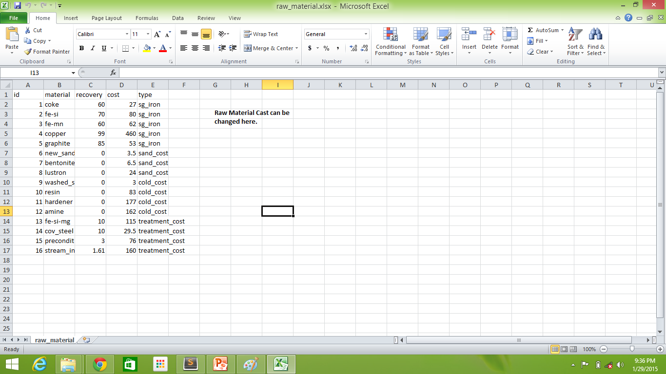
File Name: raw_material.xlsx

Slide 39
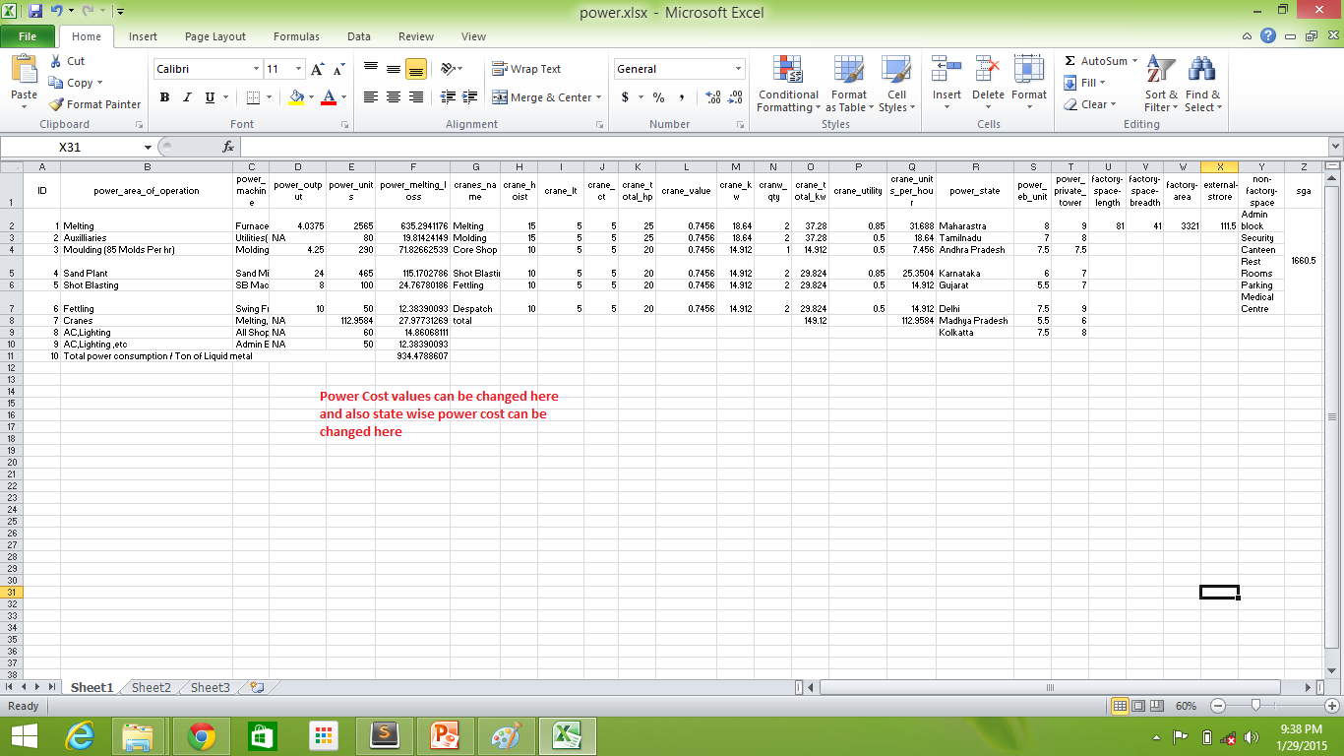
File Name: power.xlsx

Slide 40
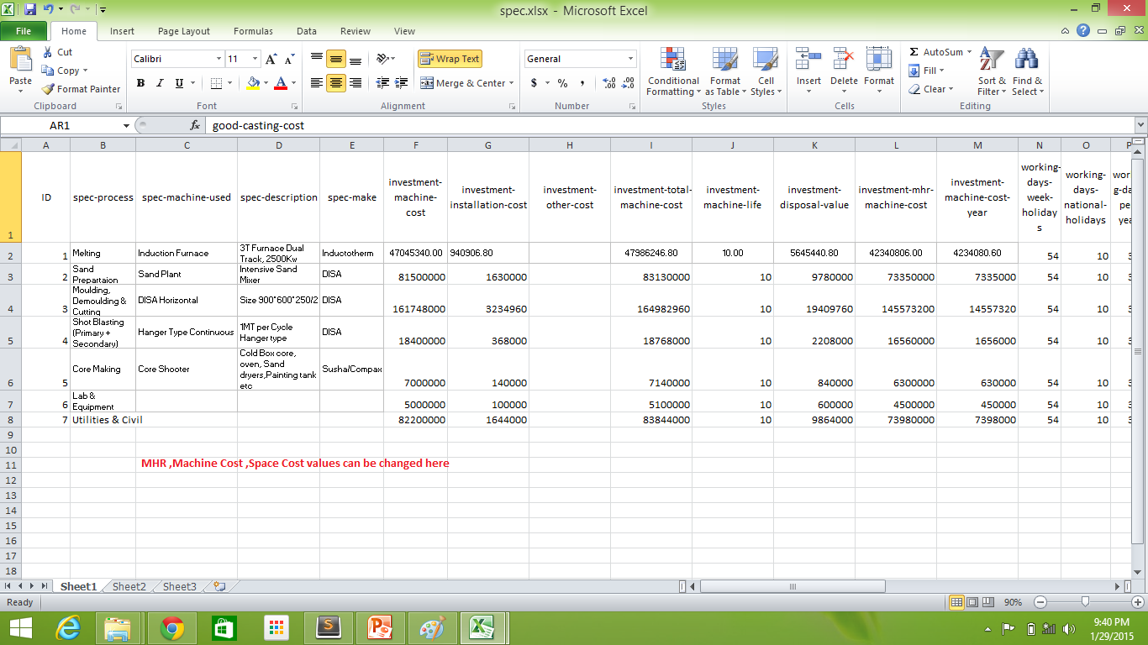
File Name: spec.xlsx

Slide 41
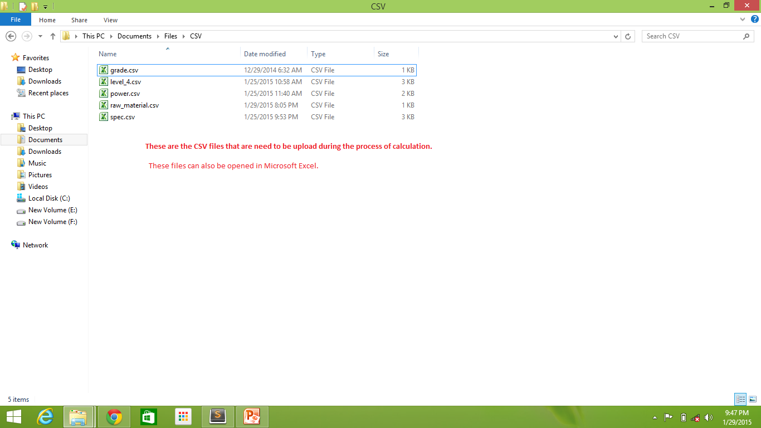
CSV FILES

Slide 42
Format of Saving Files
Any Modification that has t be done in excel and save in .xlsx format
To create the CSV File open the modified excel file and do the following:
File -> SaveAs
File name be the same
Change the Save as type to CSV (comma delimited)(*.csv)

Slide 43
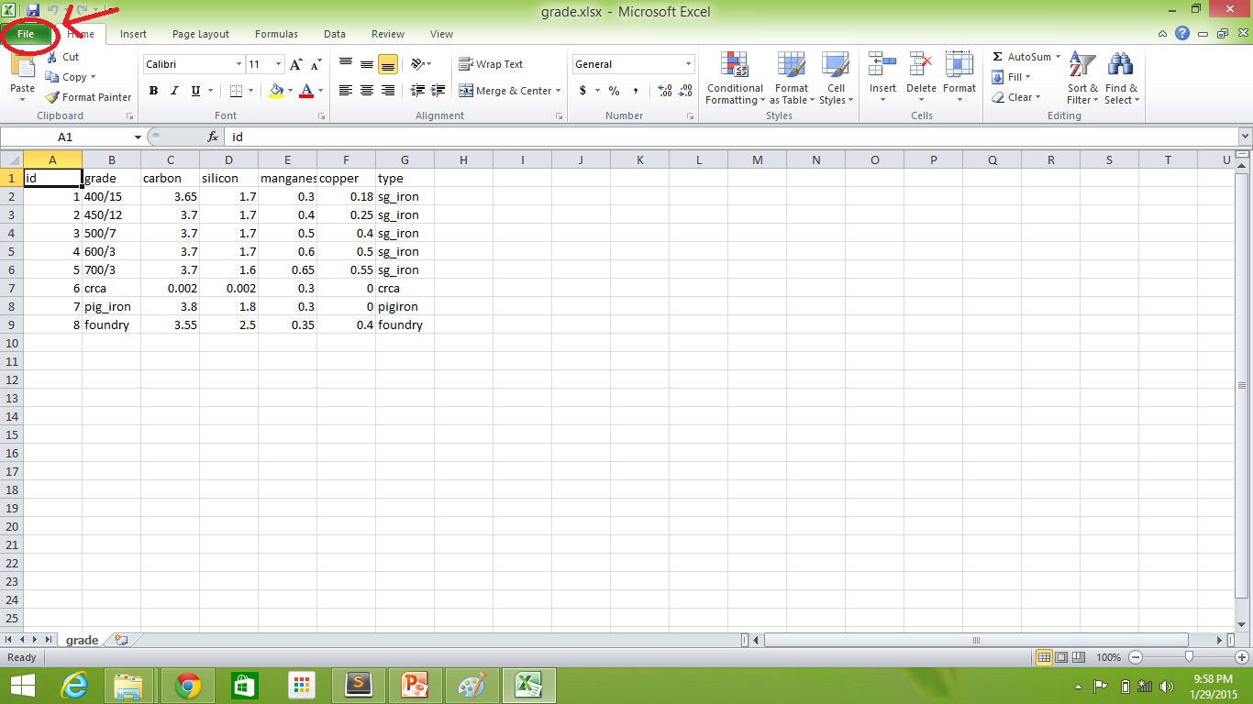

Slide 44
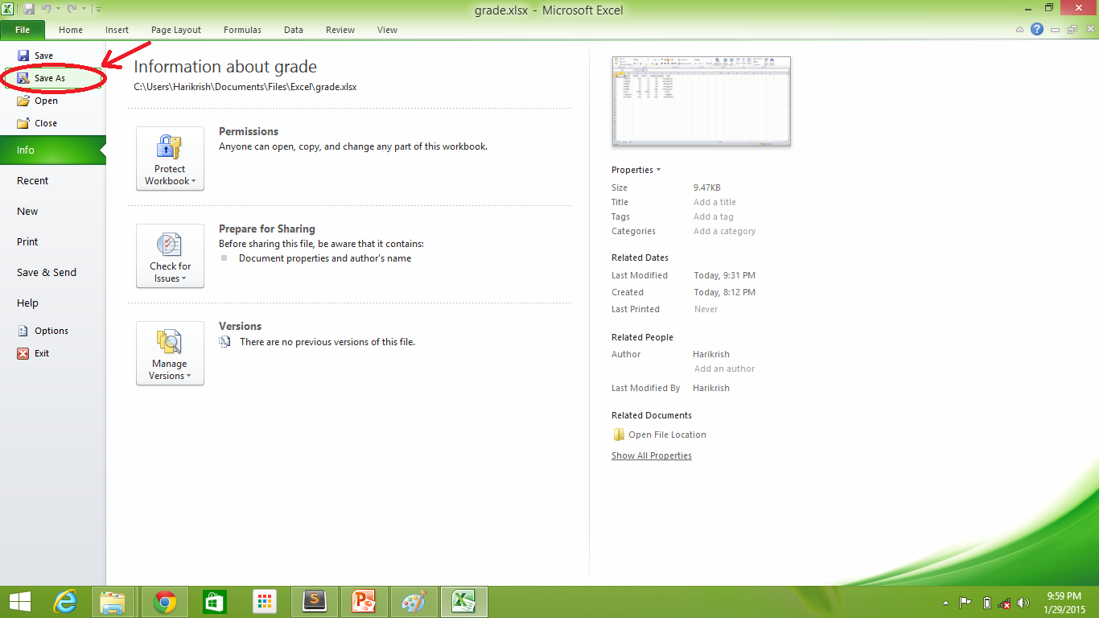

Slide 45
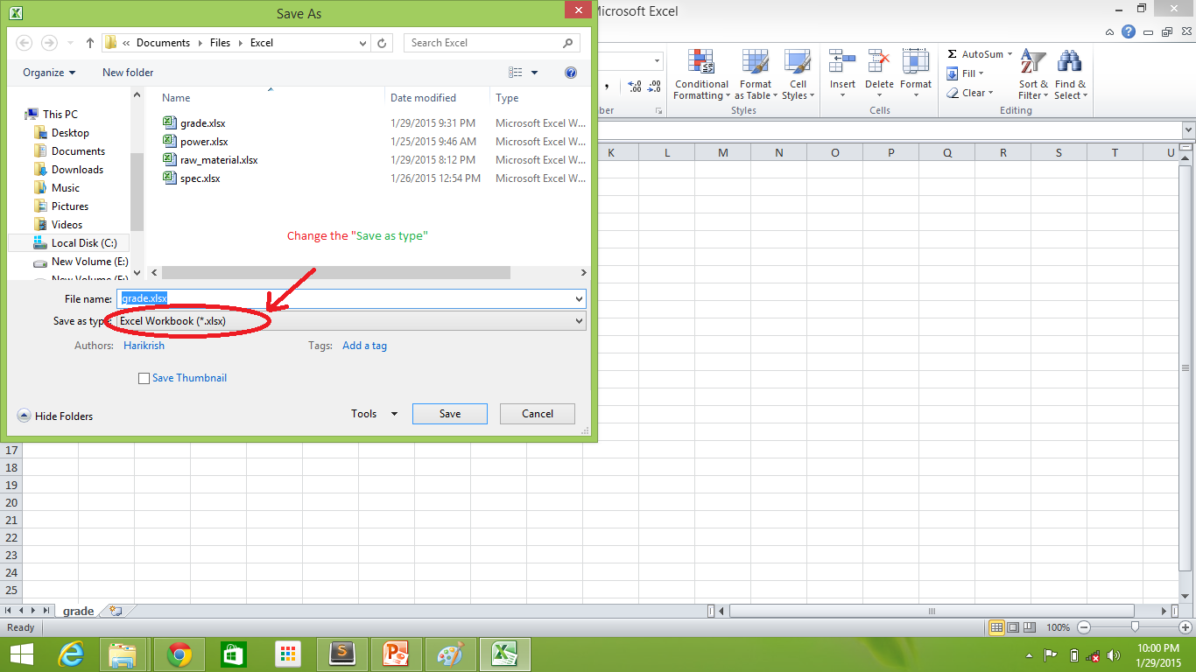

Slide 46
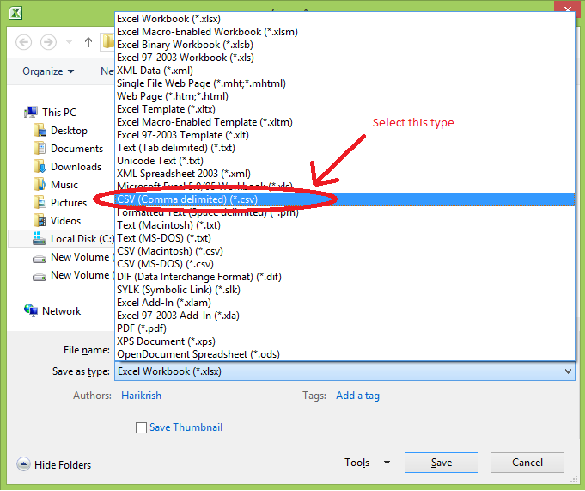

Slide 47
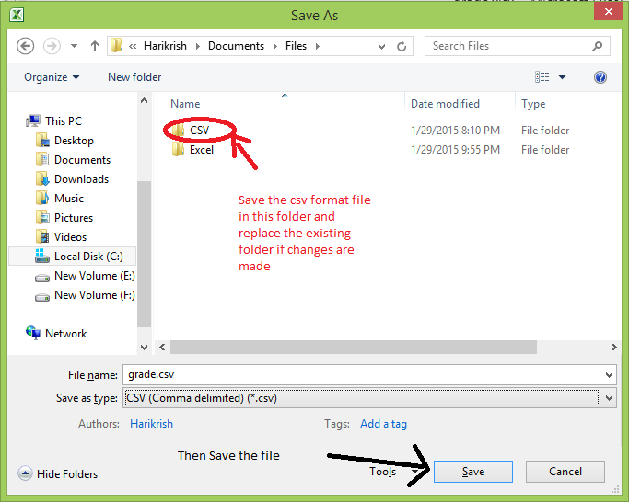

Slide 48
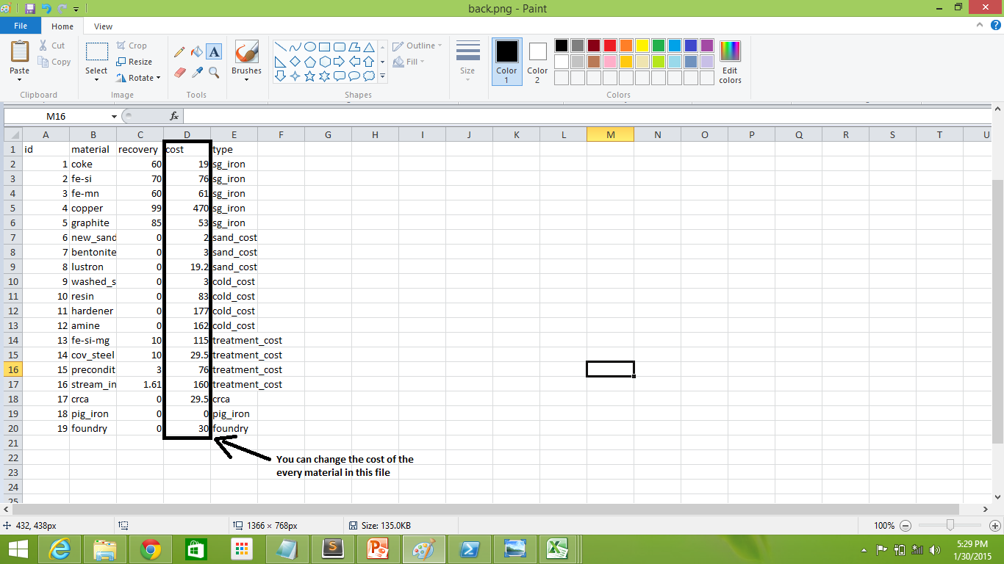
Editing the File
Change the cost of Raw materials in raw_material.xlsx and save it in raw_material.csv

